Slide 1
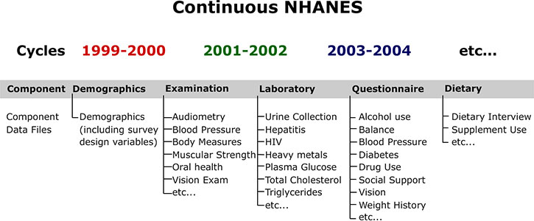
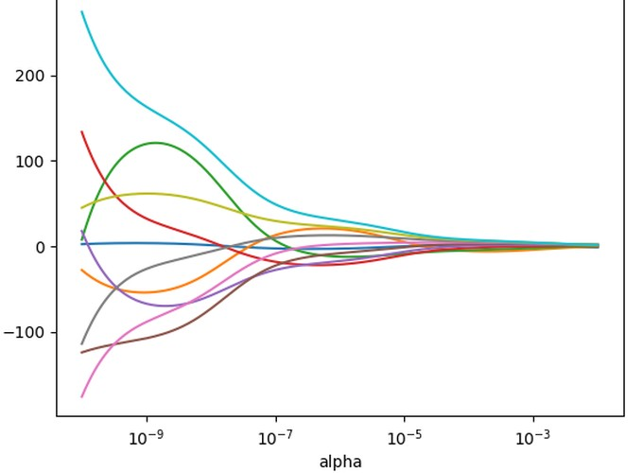
Investigating variables that influence pesticide levels in the United States (1999-2020)
Highlights
Team 29: Tendai Gwanzura, Kristina Garber, Spandana Poddutoori, Alyssa Funk, Qing Ye, Alex Li
Background
Pesticide tolerances are federally regulated, and agricultural products are surveyed annually to ensure pesticide residues are below established limits. However, more general information on human health effects over time is not well understood. We aim to identify the variables associated with changing pesticide use and increasing organic growing practices on human health in the United States over the last 20 years.
.
Dashboard Highlights
Since 1999, the survey has examined about 5,000 people in 15 different counties across the country each year. Each participant makes an important contribution to the study, representing approximately 65,000 others in the country like them
Model
Using a LASSO regression model, we used a form of linear regression model that performs L1 regularization, which is a process of introducing additional information in order to prevent overfitting.
Data
We sourced 1881 files from National Health and Nutrition Examination Survey NHANES collected from the website. These were converted from xpt format to csv format and joined based on the unique sequence number.
Conclusion

